Slide 1
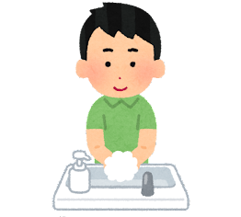
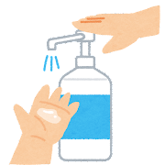
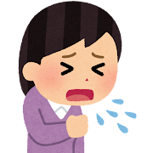
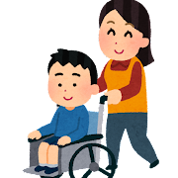
From March 13, 2023
You can take off your mask!
From usual
Hand washing is even better!
Let's do
hand washing and finger disinfection
thoroughly.
＊Hand washing and finger disinfection are fundamental to infection control.
Scene of wearing a mask
It's better to wear a scene like this!
When oneself has symptoms
(Fever, cough, etc.)
When visiting a medical institution and the elderly person’s facilities
It is important not to "pass it on to the people around you."
People who don't wear masks and people who do
Let's respect each other.
＊ As basic infection control measures, continue to "avoid crowds", "social distancing", and "ventilate".
＊ In case of spread of infection, it is recommended to wear masks according to the situation.
Shiga prefecture

